Slide 1
Graphics
Matthew Ferreira, Gabriel Kalil, GaBriel GUGA, Marco Colonna, BrandOn Peters, Eric balas

Slide 2
An abstract graphics engine(works with OpenGL as well as other API)
External Libraries:
ASSIMP – Model Loading
STB – Image Loading
GLM – Math Library
GLAD – Loading Library
Event Manager, Scene Manager, Window Manager, GameObject Manager

Slide 3
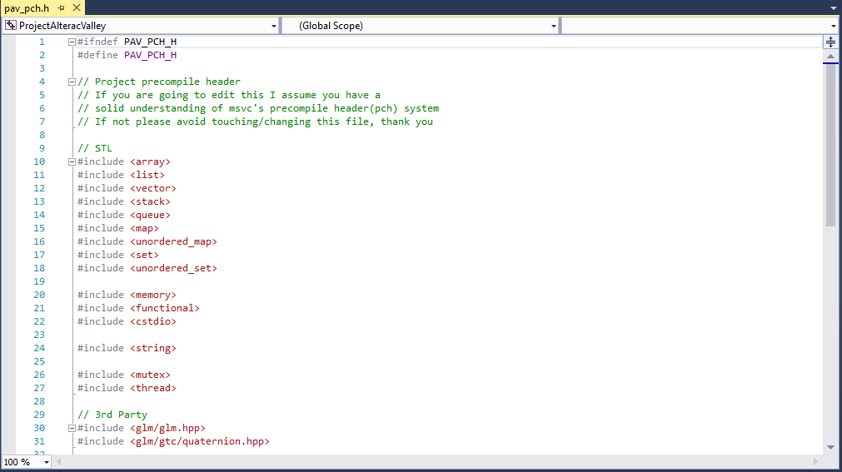
Pre-Compiled Header

Slide 4
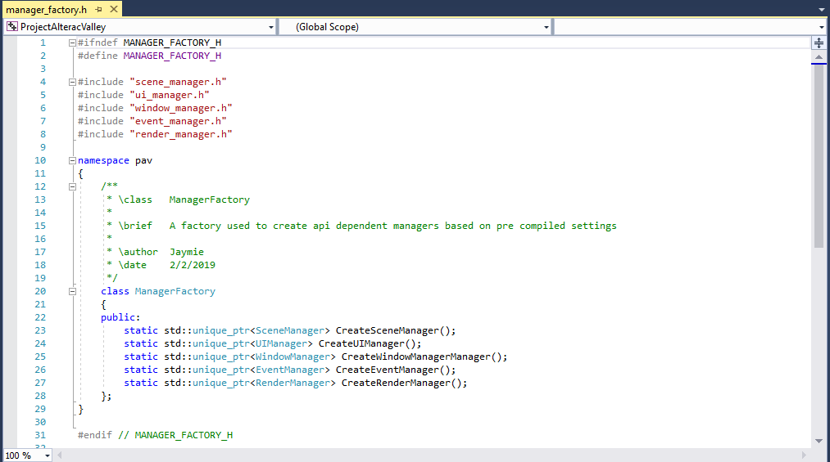
Manager Component (Manager Factory)

Slide 5
Interface Classes
Scene
Window
Renderer
Renderable Object
Shader
Texture
Etc.

Slide 6
OpenGL Specifics
OpenGL Renderable Object
OpenGL Shader
OpenGL Model Resource

Slide 7
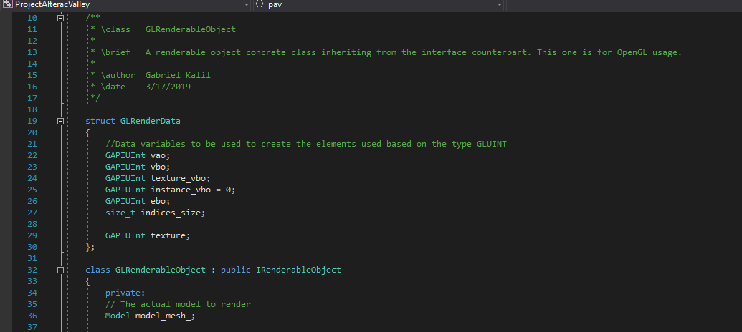

Slide 8
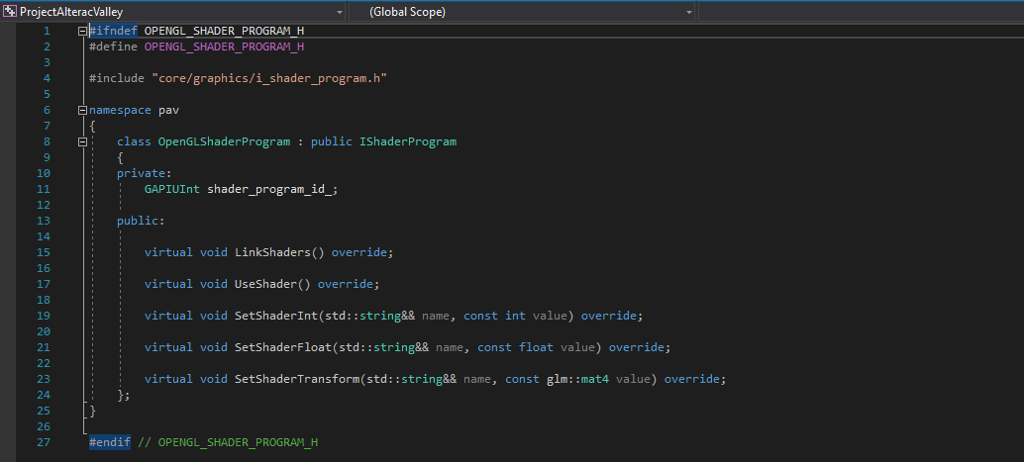

Slide 9
Future Implementation
User Interface
UI Elements (HUD, Gameplay Content)
Creation of models and meshes for loading

Slide 10
Shaders
Shaders are processes that alter the appearance of rendered graphics.
Shaders are processed on the GPU.
Shaders are written in shader languages, we’re using GL shader language(GLSL).

Slide 11
Shaders Types
Vertex Shaders
Geometry Shaders
Fragment Shaders

Slide 12
Vertex shader
Vertex shaders are shaders applied to the vertices of a mesh.
Vertex shaders are applied before shape assembly(the process of assembling vertexes into their

Slide 13
Geometry shader
Geometry shaders are shaders applied to the mesh.

Slide 14
Fragment shader
Fragment shaders are shaders applied to the pixels before they are rasterized.

